Slide 1
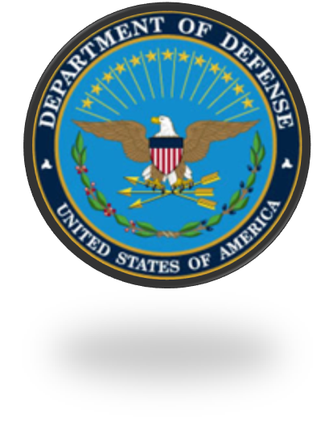
Department of Defense Combating Trafficking in Persons
General Awareness
Training Presentation
2016

Slide 2
Introduction
Welcome to the Department of Defense Trafficking in Persons General Awareness Training for Department of Defense employees. In this course, you will learn how to:
Define trafficking in persons
Identify who is involved in trafficking in persons
Determine why trafficking in persons occurs
Describe how trafficking in persons occurs
Explain how to combat trafficking in persons
Identify trafficking in persons laws and policies
NOTE: This course will use the terms "trafficking in persons" and "human trafficking" interchangeably.
Notes:
Welcome to the Department of Defense Trafficking in Persons General Awareness Training for Department of Defense employees. In this course, you will learn how to:
Define trafficking in persons
Identify who is involved in trafficking in persons
Determine why trafficking in persons occurs
Describe how trafficking in persons occurs
Explain how to combat trafficking in persons
Identify trafficking in persons laws and policies
It is important to note that the terms “trafficking in persons” and “human trafficking” will be used interchangeably

Slide 3
Warning!
This training contains language and images depicting physical violence and sexual violence to accurately portray the nature of trafficking in persons. The Department of Defense has determined that this level of candor is necessary in order to properly convey the subject matter.
Notes:
This training contains language and images depicting physical violence and sexual violence to accurately portray the nature of trafficking in persons. The Department of Defense has determined that this level of candor is necessary in order to properly convey the subject matter.

Slide 4
Introduction
International Scope
National Scope
Trafficking in Persons (TIP) is one of the fastest growing criminal industries in the world.
It is estimated that:
20.9 million people are victims of human trafficking
55% of victims are females
26% of victims are children (under 18 years of age)
In 2015,
5,544 cases of human trafficking were reported
4,136 cases involved sex trafficking
4, 683 female victims were identified
1,621 child victims were identified
Notes:
Now let’s discuss the scope of human trafficking around the world. According to the United Nations, International Labor Organization Trafficking in Persons or TIP is one of the world’s fastest growing criminal industries and it is estimated that over 20 million people are victims of human trafficking.
The United States is not immune to the problem of trafficking in persons. According to the National Human Trafficking Resource Center, in 2015 5,544 cases of human trafficking were reported in the United States. 4,136 cases involved sex trafficking. Victims include both male and female, and adult and child.
SOURCES: United Nations, International Labour Organization (ILO), National human Trafficking Resource Center (NHTRC)

Slide 5
What is TIP?
The United States government enacted the Trafficking Victims Protection Act (TVPA) in 2000, defining severe forms of trafficking as:
sex trafficking in which a commercial sex act is induced by force, fraud or coercion, or in which a person induced to perform such act has not attained 18 years of age; or
the recruitment, harboring, transportation, provision, or obtaining of a person for labor or services, through the use of force, fraud, or coercion for the purpose of subjection to involuntary servitude, peonage, debt bondage, or slavery.
Notes:
The US Trafficking Victims Protection Act or TVPA in 2000 defined severe forms of trafficking as:
-sex trafficking in which a commercial sex act is induced by force, fraud or coercion, or in which a person induced to perform such act has not attained 18 years of age; or
-the recruitment, harboring, transportation, provision, or obtaining of a person for labor or services, through the use of force, fraud, or coercion for the purpose of subjection to involuntary servitude, peonage, debt bondage, or slavery

Slide 6
Definition: “Severe forms of trafficking in persons”
All human trafficking crimes are a serious matter.
“Severe forms of trafficking” involves the recruitment, harboring, transportation, provision, patronizing, soliciting, or obtaining of a person for labor or services, through the use of force, fraud, or coercion for the purpose of forced labor.
Notes:
The definition of trafficking in persons includes the term “severe”. “Severe forms of trafficking” involves the recruitment, harboring, transportation, provision, patronizing, soliciting, or obtaining of a person for labor or services, through the use of force, fraud, or coercion for the purpose of forced labor.

Slide 7
Force, Fraud and Coercion
Trafficking in persons typically involves the use of force, fraud, or coercion to compel a person to provide:
Labor or Services (Labor Trafficking)
Commercial Sex (Sex Trafficking)
Any minor (under 18 years of age) involved in commercial sex is a victim of trafficking in persons
Notes:
Trafficking in persons primarily involves the use of force, fraud, or coercion to compel a person to provide labor or commercial sex. It is important to note that any minor or person under 18 years of age involved in commercial sex is a victim of trafficking in persons.

Slide 8
Sex Trafficking
Sex trafficking occurs when a commercial sex act is induced by force, fraud, or coercion, or in which the person who is induced to perform such an act is under the age of 18.
Victims of sex trafficking can be found working anywhere, but are most often found in:
Bars and brothels
Dance clubs and strip clubs
Massage parlors and spas
Escort services
Private parties
Example: In 2014, the Naval Criminal Investigative Service (NCIS) initiated an investigation after receiving two anonymous web tips alleging sex trafficking of a minor by a U.S. Navy Service member. The tips alleged a Navy petty officer third class was actively trafficking the minor for the purposes of prostitution in Georgia, North Carolina, and Virginia.
The investigation confirmed the petty officer paid for the minor’s escort service advertisements on an internet website and drove her to and from prostitution encounters. The minor told authorities she engaged in prostitution in multiple jurisdictions and gave the proceeds to the petty officer. The petty officer pleaded guilty to transporting the minor interstate to engage in racketeering and was sentenced to five years’ confinement in a Federal penitentiary and three years of supervised probation. He was also ordered to register as a sex offender.
Notes:
As defined by the Trafficking Victims Protection Act (TVPA) of 2000 {22 U.S.C. Section 7102(10)}, sex trafficking involves the recruitment, harboring, transportation, provision, patronizing , soliciting, or obtaining of a person for the purpose of commercial sex.
PHOTO LOCATION: TIP Report 2014, page 24

Slide 9
Labor Trafficking
Forced labor, also referred to as labor trafficking, is defined as the recruitment, harboring, transportation, provision, or obtaining of a person for labor or services, through the use of force, fraud, or coercion for the purpose of subjection to involuntary servitude, peonage, debt bondage, or slavery.
Labor trafficking occurs in the Department of Defense both domestically and internationally. Labor trafficking most commonly occurs in Department of Defense contracts that are labor intensive. These labor intensive industries include:
Domestic servitude, such as nannies and maids
Sweatshop factories
Construction sites
Farm work
Restaurants
Panhandling
Example: In 2011, the United States Air Force initiated a labor trafficking investigation based on the following allegations against a subcontractor in Iraq: Delaying the payment of salaries to contracted drivers for over three months; withholding employee passports; coercing employees to sign fraudulent employment contracts.
Notes:
As defined in the Federal Acquisition Regulation (FAR) Subpart 22.17, severe forms of trafficking involves the recruitment, harboring, transportation, provision, patronizing, soliciting, or obtaining of a person for labor or services, through the use of force, fraud, or coercion for the purpose of forced labor.
PHOTO LOCATION: TIP Report 2016, page 29

Slide 10
Child Soldiering
As defined by the Trafficking Victims Protection Reauthorization Act of 2008 (22 U.S.C. § 2370c), the term child soldier means—(i) any person under 18 years of age who takes a direct part in hostilities as a member of governmental armed forces; (ii) any person under 18 years of age who has been compulsorily recruited into governmental armed forces; (iii) any person under 15 years of age who has been voluntarily recruited into governmental armed forces; or (iv) any person under 18 years of age who has been recruited or used in hostilities by armed forces distinct from the armed forces of a state.
In some circumstances in the United States Department of Defense, parental consent allows for an individual to be voluntarily recruited into the military when under 18 years of age.
Example: In 2012, armed terrorist groups in Afghanistan reportedly recruited and used 47 children as child soldiers. They used most of the children to manufacture and plant improvised explosive devices and to transport provisions. They used at least 10 to conduct suicide attacks. During the same year, a 16-year-old boy killed himself while conducting a suicide attack at the entrance to the International Security Assistance Force (ISAF) headquarters in Kabul, Afghanistan. During the attack, seven children were killed and two others injured.
Notes:
As defined by the Trafficking Victims Protection Reauthorization Act of 2008 (22 U.S.C. § 2370c), the term child soldier means—(i) any person under 18 years of age who takes a direct part in hostilities as a member of governmental armed forces; (ii) any person under 18 years of age who has been compulsorily recruited into governmental armed forces; (iii) any person under 15 years of age who has been voluntarily recruited into governmental armed forces; or (iv) any person under 18 years of age who has been recruited or used in hostilities by armed forces distinct from the armed forces of a state.
Child soldiers can be found in different locations around the world. Countries identified as using child soldiers in governmental armed forces or government supported armed groups have been found in Burma, Central African Republic, Democratic Republic of the Congo, Rwanda, Somalia, South Sudan, Sudan, Syria, and Yemen. These countries currently have restrictions placed on them for violating the Child Soldier Protection Act (CSPA) of 2008. Rogue militias, insurgent and counterinsurgent, and terrorist groups also use child soldiers in various parts of the world.

Slide 11
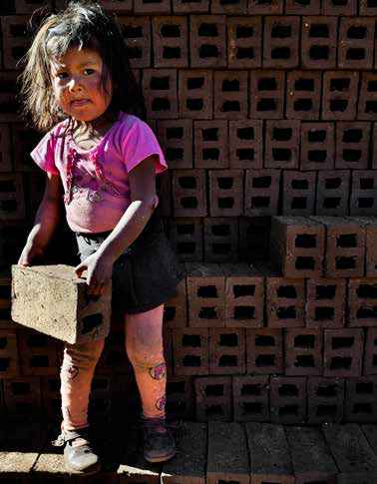
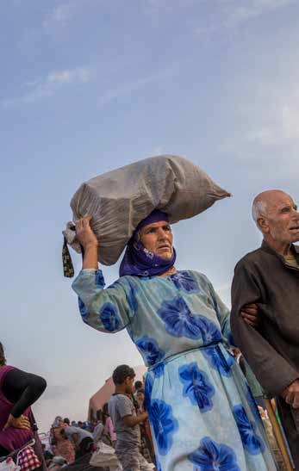
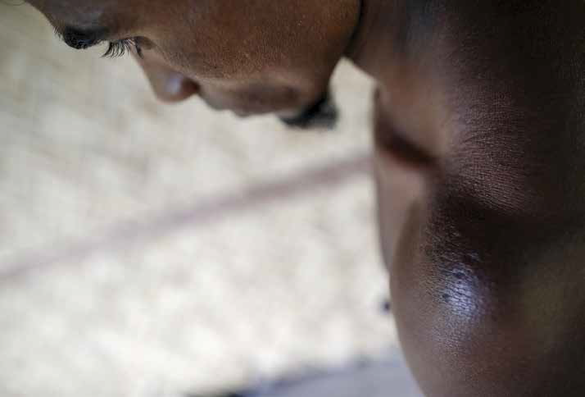
Who is Involved in TIP?
Victim Profiles
Trafficking in persons is caused when someone’s vulnerability is exploited.
Victims can be:
Any gender, age, race, nationality, social status, economic or immigration status
Man or woman
Adult or child
Foreign national or United States citizen
Notes:
Who is the typical human trafficking victim? We may have a predetermined opinion of what victims of human trafficking look like but the reality is that a human trafficking victim is a vulnerable person that has been exploited. Victims range in age, race, nationality and even social status.
PHOTO LOCATION: 2016 TIP Report, Introduction

Slide 12
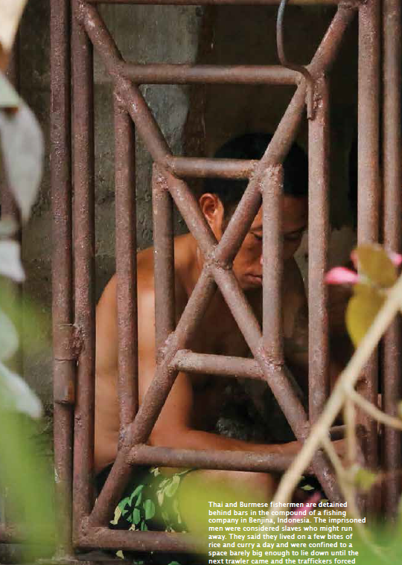
Potential Indicators
Signs of physical abuse, physical restraint, confinement
Signs of emotional or verbal abuse, fear, anxiety, submissive behaviors, or nervousness
Legal documents, money, personal possessions held by another person
No freedom of movement and/or constantly monitored by the employer/exploiter
Restricted, mediated, or controlled communications
Children under the age of 18 engaging in commercial sex acts
Required to meet a daily or nightly quota through sex acts
Unpaid, paid very little, or only earn money through tips
No permitted work breaks or days off and working long hours
Dependent on controller/employer for necessities, food, housing, etc.
No knowledge about their work contract and their basic human rights
Living and/or working in unsafe and unsanitary conditions
Notes:
The first thing we can do to combat human trafficking is to recognize the signs. When you observe others look for signs of physical abuse such as bruises, notice if someone is being escorted places or if they’re being watched. Pay close attention to a persons behavior.
Look for signs as to whether or not a person is depressed, lives in and is confined to a work site or has an apparent lack of free will.
PHOTO LOCATION: TIP Report 2015, page 15

Slide 13
Appropriate Action
If you detect a trafficking in persons situation, do not get directly involved. Report the situation to the appropriate authority.
Chain of command
Department of Defense Inspector General (IG) Hotline (1-800-424-9098, http://www.dodig.mil/hotline/)
The Hotline provides a confidential avenue for any individual to report allegations of wrongdoing that fall under the purview of the Department of Defense, including trafficking in persons.
Notes:
You should never ignore a situation that appears to involve trafficking in persons. While you might be inclined to investigate or rescue a person it is not safe to act on your own. It is not your responsibility to investigate a situation if you suspect trafficking in persons. You should call the Department of Defense IG Hotline at 1-800-424-9098 and report the incident through your chain of command.
When in doubt always report situations of human trafficking once you have identified human trafficking indicators.

Slide 14
U.S. Government’s Zero Tolerance Policy
The United States initially adopted a zero tolerance policy with the signing of the National Security Presidential Directive 22 (NSPD-22) in 2002.
DoD Instruction 2200.01, “Combating Trafficking in Persons (CTIP),” established DoD TIP policies, responsibilities, and reporting requirements for promoting the U.S. Government’s zero tolerance policy within the DoD.
Notes:
In 2002, the United States adopted a zero tolerance policy on trafficking in persons when the President signed the National Security Presidential Directive 22. In addition to this document the DoD Instruction 2200.01 establishes DoD human trafficking policies, responsibilities and reporting requirements in order to maintain a zero tolerance policy within the Department of Defense.

Slide 15
Executive Order 13627
Executive Order 13627, 2012 – “Strengthening Protections Against Trafficking in Persons in Federal Contracts.”
Strengthens the efficacy of the Government’s zero-tolerance policy on trafficking in persons by calling for stronger prohibitions on contractor engagement in human trafficking-related activities, new tailored compliance measures particularly in at-risk industries and sectors, and additional training in support of monitoring, identification, and compliance efforts.
Notes:
Strengthens the efficacy of the Government’s zero-tolerance policy on trafficking in persons by calling for stronger prohibitions on contractor engagement in human trafficking-related activities, new tailored compliance measures particularly in at-risk industries and sectors, and additional training in support of monitoring, identification, and compliance efforts.

Slide 16
National Defense Authorization Act (NDAA)
Allows the Government to terminate a contract if the prime or subcontractor commits act that directly support or advance trafficking in persons. Such acts include:
Confiscating an employee's identity or immigration documents,
Offering employment using fraudulent or misleading pretenses,
Charging placement or recruitment fees, and
Providing housing that fails to meet the host country housing and safety standards.
Notes:
Allows the Government to terminate a contract if the prime or subcontractor commits act that directly support or advance trafficking in persons. Such acts include: confiscating an employee's identity or immigration documents, offering employment using fraudulent or misleading pretenses, charging placement or recruitment fees, and providing housing that fails to meet the host country housing and safety standards.

Slide 17
Trafficking Victims Protection Reauthorization Act (TVPA)
Established a comprehensive approach to trafficking in persons by creating new criminal offenses, and establishing protection and assistance for victims.
The most recent update expands the definition of sex trafficking to include those patronizing and soliciting commercial sex.
Provides resources for holistic services for survivors
Prohibits United States funds going to any country using child soldiers
imposes reporting and compliance requirements on federal agencies, including the Department of Defense to ensure United States Government taxpayer money does not support human trafficking.
Notes:
The TVPRA 2013 is a reauthorization of the Trafficking Victims Protection Act (TVPA) 2000, which established a comprehensive approach to trafficking in persons by creating new criminal offenses, and establishing protection and assistance for victims. The most recent update expands the definition of sex trafficking to include those patronizing and soliciting commercial sex. Among other things, the TVPRA 2013 also provides resources for holistic services for survivors, prohibits United States funds going to any country using child soldiers, and imposes reporting and compliance requirements on federal agencies, including the Department of Defense to ensure United States Government taxpayer money does not support human trafficking.

Slide 18
Federal Acquisition Regulation (FAR) 22.1703
Contractors hired by the Government, and their subcontractors and employees, cannot:
Engage in severe forms of trafficking in persons
Procure commercial sex acts
Use forced labor
Deny access by an employee to the employee’s identity or immigration documents
Use misleading or fraudulent practices during recruitment or offering of employment, or Use recruiters that do not comply with local labor laws
Charge recruitment fees
Fail to provide return transportation upon the end of employment
Provide housing that fails to meet the host country housing and safety standards
Fail to provide an employment contract in the employee’s native language
Notes:
The United States Government has adopted a zero-tolerance policy regarding trafficking in persons. This policy states that contractors hired by the Government, and their subcontractors and employees, cannot:
Engaging in severe forms of trafficking in persons during the period of performance of the contract
Procuring commercial sex acts during the period of performance of the contract
Using forced labor during the period of performance of the contract
Destroying, concealing, confiscating or otherwise denying access by an employee to the employee’s identity or immigration documents
Using misleading or fraudulent practices during the recruitment of employees or offering employment
Charging recruitment fees.
Failing to provide return transportation or pay for the cost of return transportation upon the end of employment, for an employee who is not a national of the country in which the work is taking place and who was brought into that country for the purpose of working on a U.S. Government contract or subcontract.
Providing or arranging housing that fails to meet the host country housing and safety standards.
If required by law or contract, failing to provide an employment contract, recruitment agreement, or other required work documents in writing.

Slide 19
Federal Acquisition Regulation (FAR) 22.1703
Contractors are also required to:
Notify employees of prohibited activities
Certify that they have a CTIP compliance plan
Disclose to the contracting officer and the agency Inspector General information sufficient to identify the nature and extent of an offense and the individuals responsible for the conduct
Provide timely and complete responses to Government auditors' and investigators' requests for documents
Cooperate fully in providing reasonable access to their facilities and staff to allow contracting agencies and other responsible Federal agencies to conduct audits, investigations, or other actions to ascertain compliance with trafficking in persons laws and regulations
Protect all employees suspected of being victims or witnesses
Notes:
FAR subpart 22.17 requires contractors and subcontractors to notify employees of the prohibited activities described in paragraph (a) of this section and the action that may be taken against them for violations and imposes suitable remedies, including terminating contractors that fail to comply with the requirements of paragraph (a) and (b) of this section. Contractors also required to:
Notify employees of prohibited activities
Certify that they have a CTIP compliance plan
Disclose to the contracting officer and the agency Inspector General information sufficient to identify the nature and extent of an offense and the individuals responsible for the conduct
Provide timely and complete responses to Government auditors' and investigators' requests for documents
Cooperate fully in providing reasonable access to their facilities and staff to allow contracting agencies and other responsible Federal agencies to conduct audits, investigations, or other actions to ascertain compliance with trafficking in persons laws and regulations
Protect all employees suspected of being victims or witnesses
It is important to note that FAR Clause 52.222-50 should be inserted into Federal solicitations, contracts and subcontracts.

Slide 20
Defense Federal Acquisition Regulation Supplement (DFARS) 222.17
Supplements the Federal Acquisition Regulation (FAR) Subpart 22.17 in codifying the zero-tolerance policy against human trafficking in Department of Defense supply chains as implemented through PGI 222.17.
This supplement includes requirements to:
Adhere to DoD policy, instructions for reporting violations and imposing remedies, procedures for audits.
Lists CTIP provisions that must be included in all solicitations and contracts.
Notes:
Supplements the Federal Acquisition Regulation (FAR) Subpart 22.17 in codifying the zero-tolerance policy against human trafficking in Department of Defense supply chains as implemented through PGI 222.17. This supplement includes requirements to adhere to DoD policy, instructions for reporting violations and imposing remedies, procedures for audits. It also lists CTIP provisions that must be included in all solicitations and contracts.

Slide 21
Uniform Code of Military Justice (UCMJ)
Criminal code that applies to Service members and in time of declared war or a contingency operation, persons serving with or accompanying an armed force in the field.
Offenses related to sex trafficking may be prosecuted under UCMJ including
Prostitution
Patronizing a prostitute
Pandering by compelling
Inducing, enticing, or procuring an act of prostitution
Pandering by arranging or receiving consideration for arranging for sexual intercourse or sodomy.
Notes:
The UCMJ is the criminal code that applies to Service members and in time of declared war or a contingency operation, persons serving with or accompanying an armed force in the field. Offenses related to sex trafficking may be prosecuted under UCMJ including prostitution; patronizing a prostitute; pandering by compelling, inducing, enticing, or procuring an act of prostitution; and pandering by arranging or receiving consideration for arranging for sexual intercourse or sodomy.

Slide 22
Justice for Victims of Trafficking Act (JVTA)
The JVTA enhances victims services and increases training for federal personnel. Provisions include:
Increases penalties for traffickers and buyers
Establishes a Domestic Trafficking Victims Fund to increase victim assistance
Eases the requirements for U.S. citizens and legal permanent residents to obtain benefits and services
Requires training for federal government personnel related to TIP
Creates a Child Exploitation Investigations Unit within DHS Cyber Crimes Center
Requires DoD to provide DoJ with sex offender registration information for persons required to register who are released from military corrections facilities or convicted under the Uniform Code of Military Justice (UCMJ) and sentences without confinement

Slide 23
Conclusion
Congratulations!
You have almost completed the Department of Defense Trafficking in Persons General Awareness Training.
In this training, you learned how to:
Define trafficking in persons
Identify who is involved in trafficking in persons
Determine why trafficking in persons occurs
Describe how trafficking in persons occurs
Explain how to combat trafficking in persons
Identify trafficking in persons laws and policies
Notes:
Thank you for viewing this General Awareness presentation on Combating Trafficking in Persons. In this presentation you learned how to define human trafficking, identify who is involved in the process of trafficking in persons, determine why trafficking in persons occurs, describe how trafficking in persons occurs, explain how to combat human trafficking, and identify CTIP laws and polices.
Now that you’ve successfully viewed this power point please contact your Training POC to request your certificate of completion.

Slide 24
Resources
Federal Acquisition Regulation (FAR)
https://acquisition.gov/far/
Department of Defense Instruction (DoDI) 2200.01
http://www.dtic.mil/whs/directives/corres/pdf/220001p.pdf
National Defense Authorization Act (NDAA)
http://www.govtrack.us/congress/bills/112/hr4310/text
Trafficking Victims Protection Act (TVPA)
http://www.state.gov/documents/organization/10492.pdf
Justice for Victims of Trafficking Act (JVTA)
https://www.govtrack.us/congress/bills/114/s178/text
Department of State 2015 TIP Report
http://www.state.gov/documents/organization/245365.pdf
Executive Order (EO) 13627
http://www.whitehouse.gov/the-press-office/2012/09/25/executive-order-strengthening-protections-against-trafficking-persons-fe
National Security Presidential Directive 22
http://www.combat-trafficking.army.mil/documents/policy/NSPD-22.pdf
Notes:
This presentation was developed using the following resources.

Slide 25
Department of Defense Combating Trafficking in Persons
This is to certify that
has successfully completed the CTIP training requirement
Linda K. Dixon
Linda K. Dixon, Program Manager,
Combating Trafficking in Persons Program Office
DOD Certified IAW DODI 2200.01

