Slide 1
Trafficking in Persons: US National Perspective & National Hotline
Kathleen Davis
Polaris Project

Slide 2
Agenda
Polaris Project
TIP Overview
Domestic TIP
TIP National Hotline
How military personnel can help

Slide 3
Polaris Project is committed to combating human trafficking and modern-day slavery, and to strengthening the anti-trafficking movement through a comprehensive approach.
Founded by two university students in 2002
Named after the North Star that guided slaves towards freedom along the Underground Railroad
Takes comprehensive approach to combat HT/Slavery
Direct Outreach, Transitional Housing, Social Service Support
National HT Resource Center & Hotline
National Training & Technical Training
Federal & State Policy Advocacy
Public Outreach & Communication
Notes:
Quilt image from http://ses.westport.k12.ct.us/squire/idivsquares.htm

Slide 4
TIP Overview
Trafficking Victims Protection Act (2000)
1st comprehensive federal law on CTIP
4-P: prevention, protection, prosecution, partnership
Executive Order (2002): Zero Tolerance
Sec of Defense (2004): CTIP Training
DOD.IG 2200.01 (2007): Assigned Responsibilities

Slide 5
Trafficking in Persons
(8) Severe forms of trafficking in persons
The term "severe forms of trafficking in persons" means -
(A) sex trafficking in which a commercial sex act is induced by force, fraud, or coercion, or in which the person induced to perform such act has not attained 18 years of age; or
(B) the recruitment, harboring, transportation, provision, or obtaining of a person for labor or services, through the use of force, fraud, or coercion for the purpose of subjection to involuntary servitude, peonage, debt bondage, or slavery.
(9) Sex trafficking
The term "sex trafficking" means the recruitment, harboring, transportation, provision, or obtaining of a person for the purpose of a commercial sex act.
22 USC 7102
Notes:
“Severe Forms of Trafficking in Persons”
More informally stated - Creates three different categories of human trafficking:
Minors induced by a third party into commercial sex acts (no proof of force, fraud, coercion req.)
Those 18 or over involved in commercial sex acts via force, fraud, or coercion
Those in forced labor or services, via force, fraud, or coercion (both minors and adults)

Slide 6
Action
Means
Purpose
Recruits,
Harbor,
Transports,
Provides,
OR
Obtains
(or so attempts)
Force
Coercion
Labor
or
Services
(E.g. domestic service, agriculture, hospitality services, etc)
USC §1589 Forced Labor
(Labor Trafficking)
Action
Means
Purpose
Recruits,
Harbor,
Transports,
Provides,
OR
Obtains
(or so attempts)
Coercion
Commercial
Sex Acts
(e.g. prostitution, stripping, pornography, etc)
(exception: minors)
Force
Fraud
USC §1591 Sex Trafficking

Slide 7
What TIP is NOT
Poorly paid and highly exploited labor
Q: Can a person voluntarily leave?
Duration of time
TIP is not always a permanent condition
Only movement/transportation of people
Alien Smuggling
TIP is NOT Smuggling
Crime against Human Rights v. Crime against the State
At times, it is difficult to differentiate between poorly paid and forced labor or smuggling or trafficking without further investigation

Slide 8
TIP Victims
Who?
Gender – Can Be Men and Women
Age – Can Be Adults and Children
Nationality – Can Be U.S. Citizens and Foreign Nationals
Documentation – Can Be Undocumented and Documented
Education – May Have Formal Education or be Illiterate
Number – Can Be Individuals, Families, and Groups
Human Trafficking Cuts Across Ethnicity, Gender, Age, Race, Nationality, Class, and any other demographic information Essentially, Anyone Could Become a Victim.
Essentially, it is about vulnerability

Slide 9
Human Trafficking Victims
What?
Commercial sex (brothels, street-based, stripping, pornography)
Domestic servitude (childcare, housekeeping)
Hard labor (construction, mining, agriculture)
Hospitality services (hotels, restaurants, janitorial)
Peddling/begging rings (e.g. magazine sales crews)
Child soldiers
Victims are found where there are people desperate for jobs/livelihoods and people willing to exploit them for a profit.
DEMAND
Profiteers
Exploitation

Slide 10
Traffickers
Low Risk, High Profit
Small Independently Owned Business
Contractors
Agents
International OCS
Mafia, Triads, Yakuza
Less Centralized
More Centralized
Individuals
Pimp
Neighbor
Diplomat
Small Decentralized Criminal Operations
Family/ Extended Family
Hierarchy of Pimps
Common Denominator: Willingness to exploit others for profit

Slide 11
The Demand
Individuals purchasing commercial sex
Military, Civilian, Contractors, etc
Individuals and/or companies seeking cheap labor and/or products
Knowing or not knowing forced labor involved

Slide 12
International Magnitude
12-27 million enslaved worldwide
2-4 million internally trafficked annually
600,000-800,000 internationally trafficked
Victims: 80% women and 50% children
$32 billion industry
Africa GDP $1.5 billion in 2008 (IMF)

Slide 13
DOD CTIP Training
Online and in-person CTIP training for military and civilian
Training emphasis: overseas issue and sex trafficking
Detection, reporting, and penalties for engaging
NEED to make connection TIP happens in US:
Victims: Foreign national and US citizen
Military/Civilian/Contractor: client and/or perpetrator

Slide 14
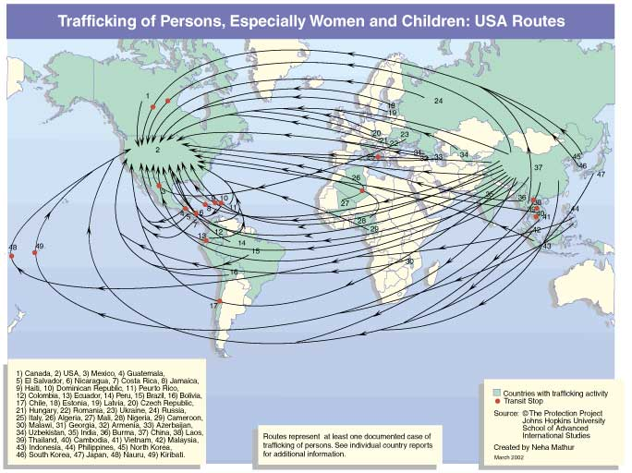

Slide 15
US National Magnitude
14,500-17,500 trafficked into USA annually
100,000-300,000 American children at high risk
450,000 homeless children
1 of 3 lured into prostitution 48 hours
Feb 2009: Operation Cross Country III
3 day operation in 29 cities
571 arrested
48 children recovered
Since 2003: 670 children recovered
Notes:
In the spring of 2003, the FBI’s Criminal Investigative Division, in partnership with the Child Exploitation-Obscenity Section (CEOS) of the Department of Justice and the National Center for Missing & Exploited Children (NCMEC), formed the Innocence Lost National Initiative to address the growing problem of children forced into prostitution.

Slide 16
Sex Trafficking Networks in US
Pimp Control
Asian Massage Parlors
Clientele: Open to all customers
Price: $500-1000 nightly quota
Locations: streets, hotels, truck stop, etc
Victims: Americans, minors
Other fronts: escort services
Advertising: online, word of mouth, business cards, etc
Clientele: Open to all customers
Price: $60-90; optional tip
Locations: store-fronts, office spaces, commercial areas
Victims: Asian, Latina women; 3-5 live onsite and rotate 2 weeks
Other fronts: health spas, nail salons, acupuncture clinics, etc
Advertising: newspaper, phonebook, online
Latino Brothels
Clientele: Latino males
Price: $30/15 mins
Locations: residential areas, rural trailers, restaurants, etc
Victims: Latina women, minors
Other fronts: Cantina hostess, escort delivery
Advertising: word of mouth, business cards

Slide 17
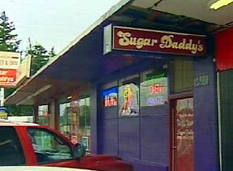
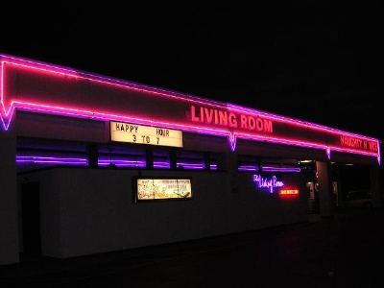
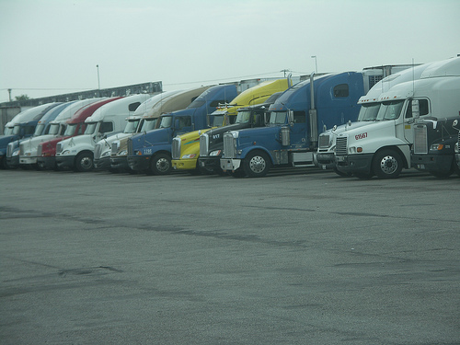
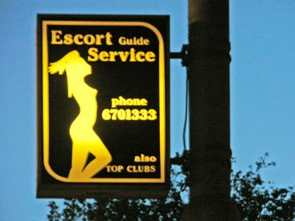
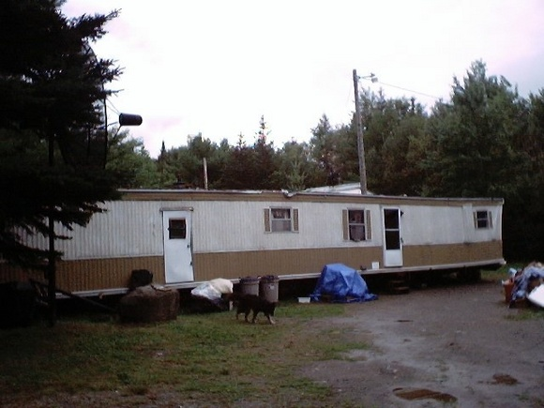
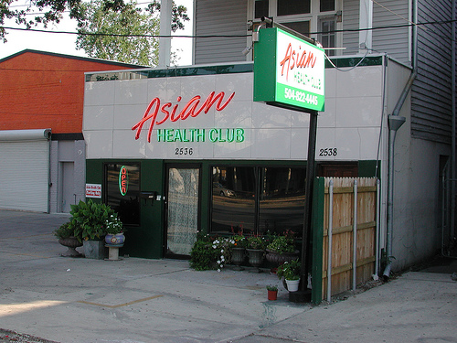
Sex Trafficking in US

Slide 18
Labor Trafficking
Economic sectors that experience high demand for cheap labor and an absence of rigorous monitoring
Ethnic trafficking rings
Restaurant: Latino/Chinese
Victims:
Homeless American men
American/FN child peddling crews
Other cases
US v. Paoletti (Deaf Mexican Peddling)
US v. Sabhnani (Domestic Servants)

Slide 19
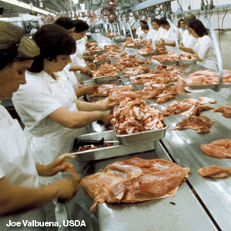
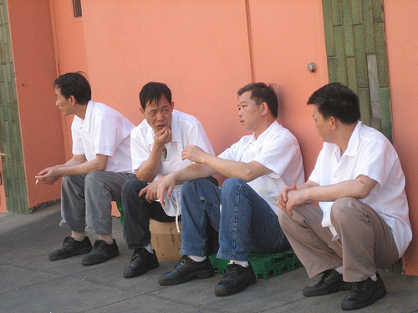
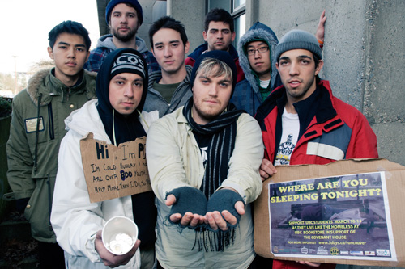
Labor

Slide 20
Why TIP is Relevant to DOD
Executive Order for DOD to combat TIP
Military/Civilian/Contractor: clients and/or perpetrators
Military Personnel Misconduct & Mission Completion
Credibility, integrity, and reputation
Internationally and nationally
Public Health
HIV/AIDS
Other transmittable diseases
Chronic health disorders from victims (e.g. respiratory)
National Security

Slide 21
Cases involving Military Personnel
SPC, Ft. Meade (5/09)
Charged: two counts TIP, two counts prostitution, count running a prostitution business and numerous drug charges
Prostituted minor and other women
Lured and held minor in apartment, posted online ads and collected all money earned
1/09 Police recovered 19 yr woman held against will
If convicted for TIP: 10 years to life in prison
Notes:
http://www.prostitutenetwork.com/article.html?3542

Slide 22
Cases involving Military Personnel
“[TIP] is a crime that erodes the integrity of the Armed Forces”
– Fort Lewis spokesperson
Sgt at Ft. Lewis (6/09)
Charged: child sex trafficking; attempted child sex trafficking
Prostituted out 16/17 year olds
Obtained apartment, purchased plane ticket, posted online ads and collected all money earned
If convicted: 10 years to life in prison, $250,000 in fines and five years of supervised release
Notes:
When arrested, had birth certificate of one of the girls
Links: www.katu.com/news/43188267.html

Slide 23
Hotline Calls involving or reported by Military & Civilian Personnel
International Deployment & TDY
Hostess bars
Hotel Brothels
Off Duty Travel
Overseas vacation for commercial sex
National
Forced labor

Slide 26
Overview of NHTRC Hotline 1-888-3737-888
Established by HHS 2004
Operated by Polaris Project (12/07)
Toll-free anywhere in the United States
24 hours a day, 365 days a year
Ability to connect with callers in 170 languages
Database of anti-trafficking and related service providers, coalitions, task forces and law enforcement
Library of anti-trafficking resources, training materials & general information

Slide 27
NHTRC Hotline:
To report a tip
To connect with anti-trafficking services in requested area
To request training and technical assistance
To request general information or specific anti-trafficking resources.

Slide 28
State by State Contacts Database
Over 3200 contacts in all 50 states and DC
Covering:
Foreign nationals
American citizens
Adults
Minors
Sex trafficking
Labor trafficking

Slide 29
Example of Types of Referrals
Anti-Trafficking Organizations and Service Providers
Local and Federal Law Enforcement
42 DOJ-funded Task Forces
Rescue and Restore Coalitions
Legal Resources
Shelters:
Emergency, Transitional and Long Term
Consultants and Researchers
Outreach and Prevention
Runaway & Homeless Youth Providers
Labor Exploitation
Immigration Resources
Domestic Violence and Sexual Assault
Substance Abuse and Mental Health
General Victims of Crime and Other National Hotlines
Case Management
We are continually building, adding and expanding the database
Notes:
Polaris Project ~ Practical Training on Victim Identification
Polaris Project ~ www.PolarisProject.org ~ Tel: 202-547-7909
29

Slide 30
Call Types: Jan – May 2009
Crisis Calls
Tips
Training &Technical Assistance
19%
6%
1%
17 calls
411 calls
123 calls
Referrals
General Information
(Un)Related Calls
12%
33%
20%
260 calls
708 calls
433 calls
Also: Complaints (0.15%), Related Calls (7%); and Unable to Determine (2%)

Slide 31
Average Call Statistics: Jan – May 2009
Total Calls to Date: 9135
Dec 07-08 Total #: 5985
Jan – May 09: 2799
Average Calls per month: 560
Average Calls per day: 18.66
Average per Business day: 26.16
Call References Potential Trafficking:
Yes: 11%
No: 76.5%
Unknown: 12.5%
Gender:
Female Callers: 66%
Male Callers: 33%
Total Number of Potential Victims Identified through Calls: 363
State Call Volume:
California
Texas
New York
Florida
Washington DC
Languages:
English: 93%
Spanish: 7%
Other: Less than 1%
Other Variables Captured: Type of Caller; Type of Trafficking; Call Reported; How the Caller Heard about Us; Type of Referral Provided

Slide 32
Calls from Dec 07- June 09
Total: 9310 Calls
Types
58% Sex Trafficking
26% Labor trafficking
2.5% Int’l Marriage Brokers
3% Sex and Labor
10.5% Other*
10+ calls referencing military
*TIP type unknown
Top 10 Call Volume States
Texas: 1112 (18.33%)
California: 1017 (16.76%)
New York: 351 (5.78%)
Florida: 338 (5.57%)
Illinois: 257 (4.24%)
DC: 225 (3.71%)
Ohio: 166 (2.74%)
Georgia: 164 (2.70%)
North Carolina: 160 (2.64%)
Virginia: 142 (2.34%)

Slide 33
Role of the Military & Civilian Personnel
Encourage Hotline posting in workspace, barracks, gym, other facilities
Encourage personnel to call hotline with tips and as a resource on TIP
Encourage personnel to educate peers about TIP and hotline

Slide 34
Report Tips, Receive Resources
National Human Trafficking Resource Center* 24-HR Hotline:
1-888-3737-888
*Operated by Polaris Project

Slide 35
Contact
Kathleen Davis
National Training Coordinator
Polaris Project
Tel: (202)745-1001 x133
Email: kdavis@polarisproject.org

